Slide 1
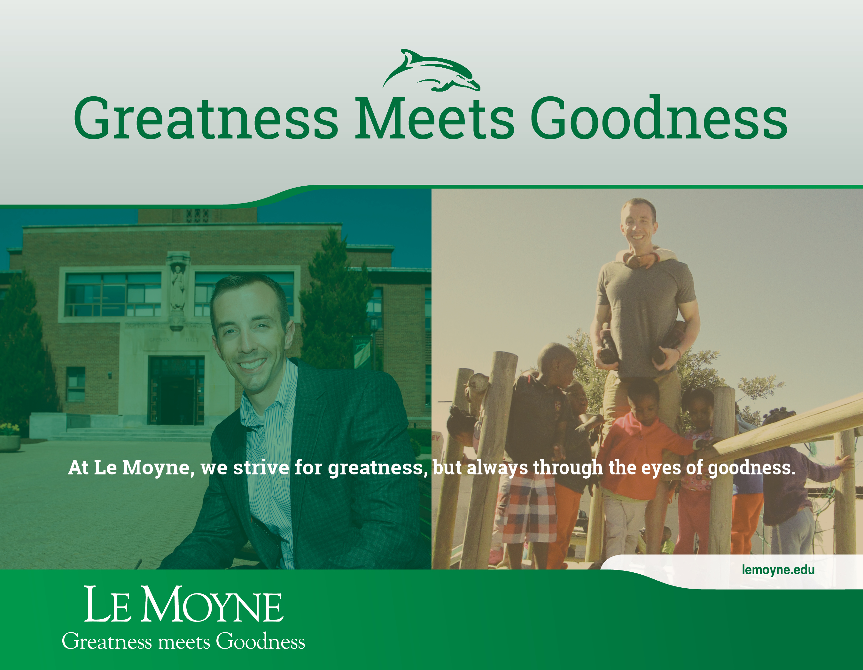

Slide 2
An education on the Heights is equal parts passion and compassion.

Slide 3
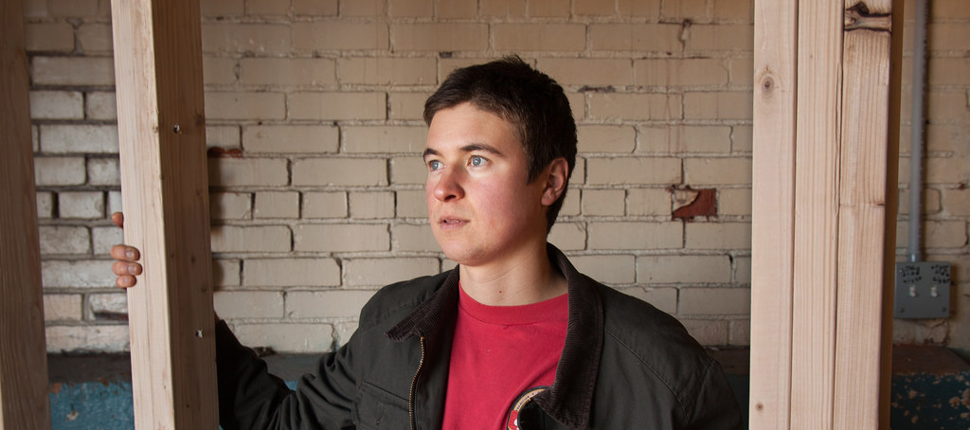
Entrepreneurship Meets Social Justice
Andrew Lunetta ’12 used his entrepreneurial spirit and passion for social justice to establish a program to aid the hungry and the homeless. Today Lunetta is the founder of A Tiny Home for Good, which develops micro-housing for formerly homeless individuals.

Slide 4
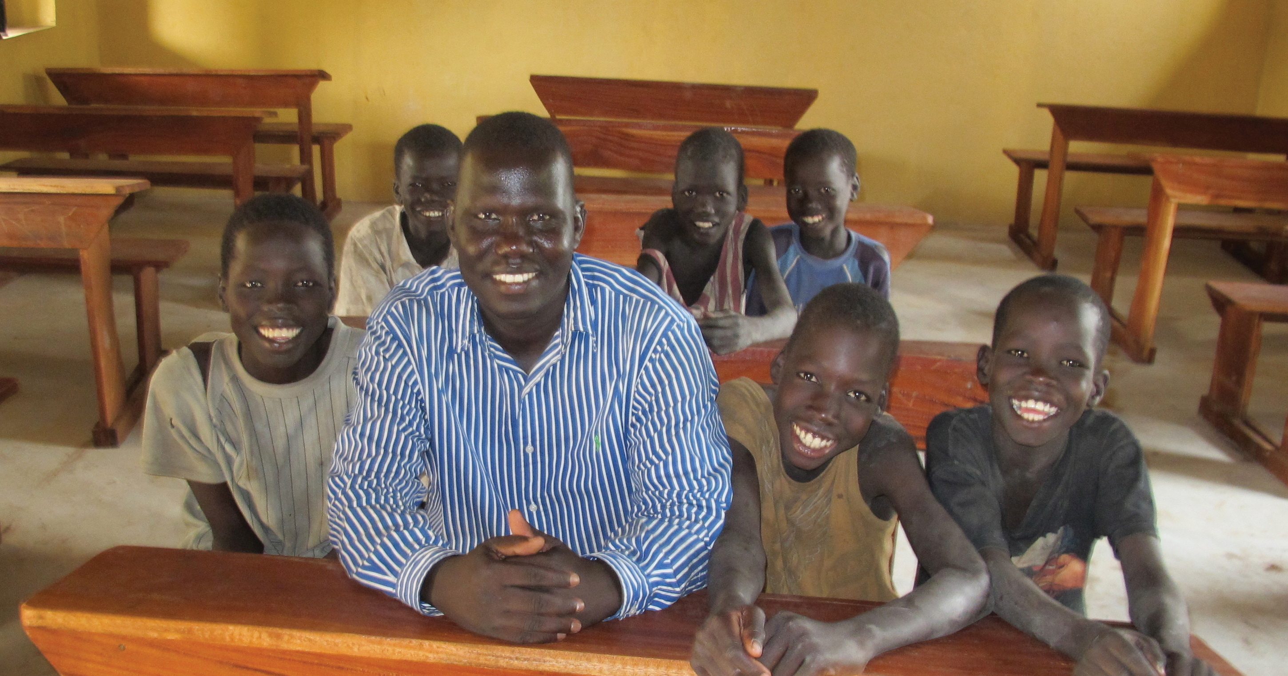
Creating a Better Life
Today more than 600 children in a small village in the Republic of South Sudan receive a great education in the school Gabriel Bol Deng ’07 created for them.

Slide 5
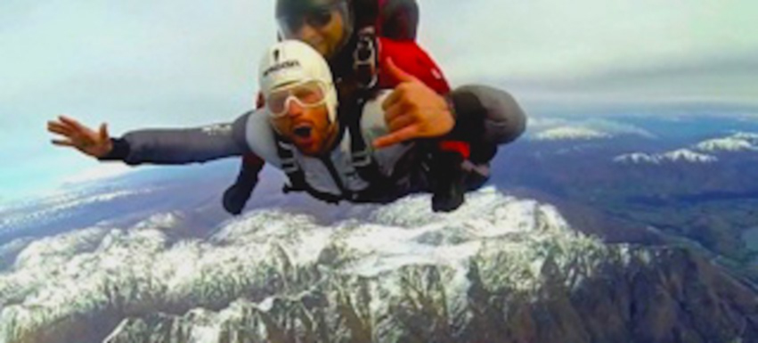
Diving into Life
Joe O’Connor’s epiphany at 15,000 feet inspired him to establish, GetLIVIN, whose mission is “to redefine how people live.” He grew the business from a blog to a series of talks at local schools to the GetLIVIN Experience, which blends adventure and self-discovery.

Slide 6
We shoot for championships, but live for sportsmanship.

Slide 7
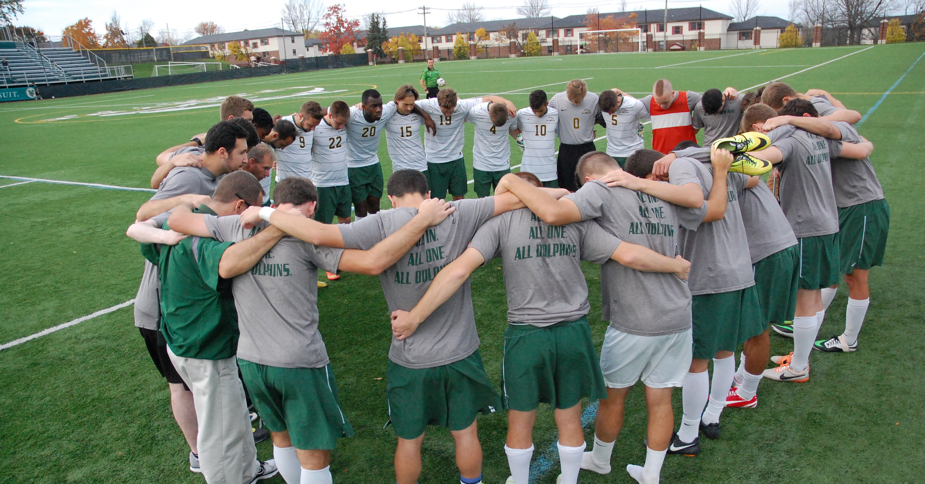
Inside the L
Inside the L is a distinctly Jesuit approach to athletics at the College that focuses on how students will live their lives long after they have graduated from Le Moyne. It encourages them to be men and women for others, to strive for the more and to find God in all things.

Slide 8
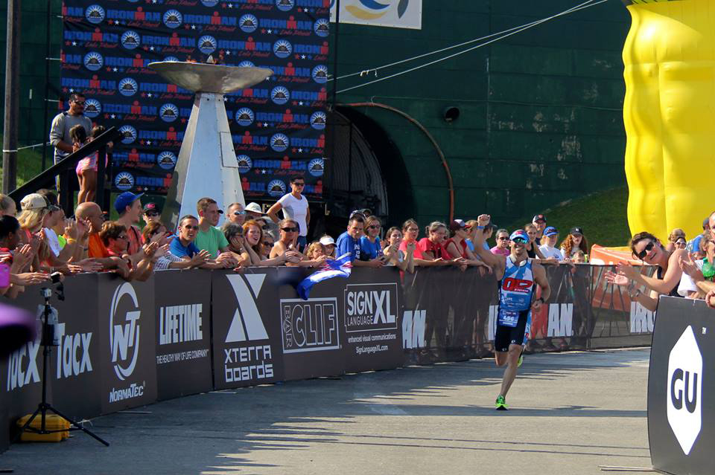
Competing for Cancer Research
Andrew Cruz ’03 was ranked in the top 1 percent of IRONMAN’s All World Athlete Program. Even more impressive is the reason Cruz began competing in triathlons – to raise money for blood cancer research after a dear friend lost his father to non-Hodgkin lymphoma.

Slide 9
We teach the skill of trading stocks, but instill the principle of never trading values.

Slide 10
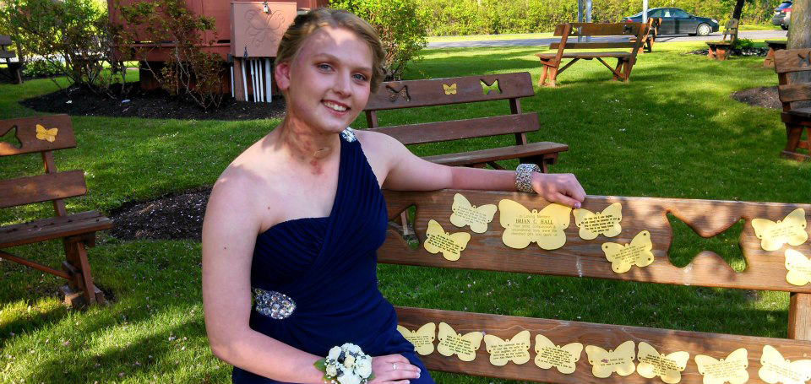
Striving for Magis
Kelleigh Gustafson ’18 was just 4 years old when she was diagnosed with a rare and potentially life-threatening condition known as arteriovenous malformation (AVM). Today Gustafson leads a busy life as a psychology major and member of the women’s golf team. She is also the founder of Kelleigh’s cause, an organization that seeks to raise awareness and funds to find a cure for AVM.

Slide 11
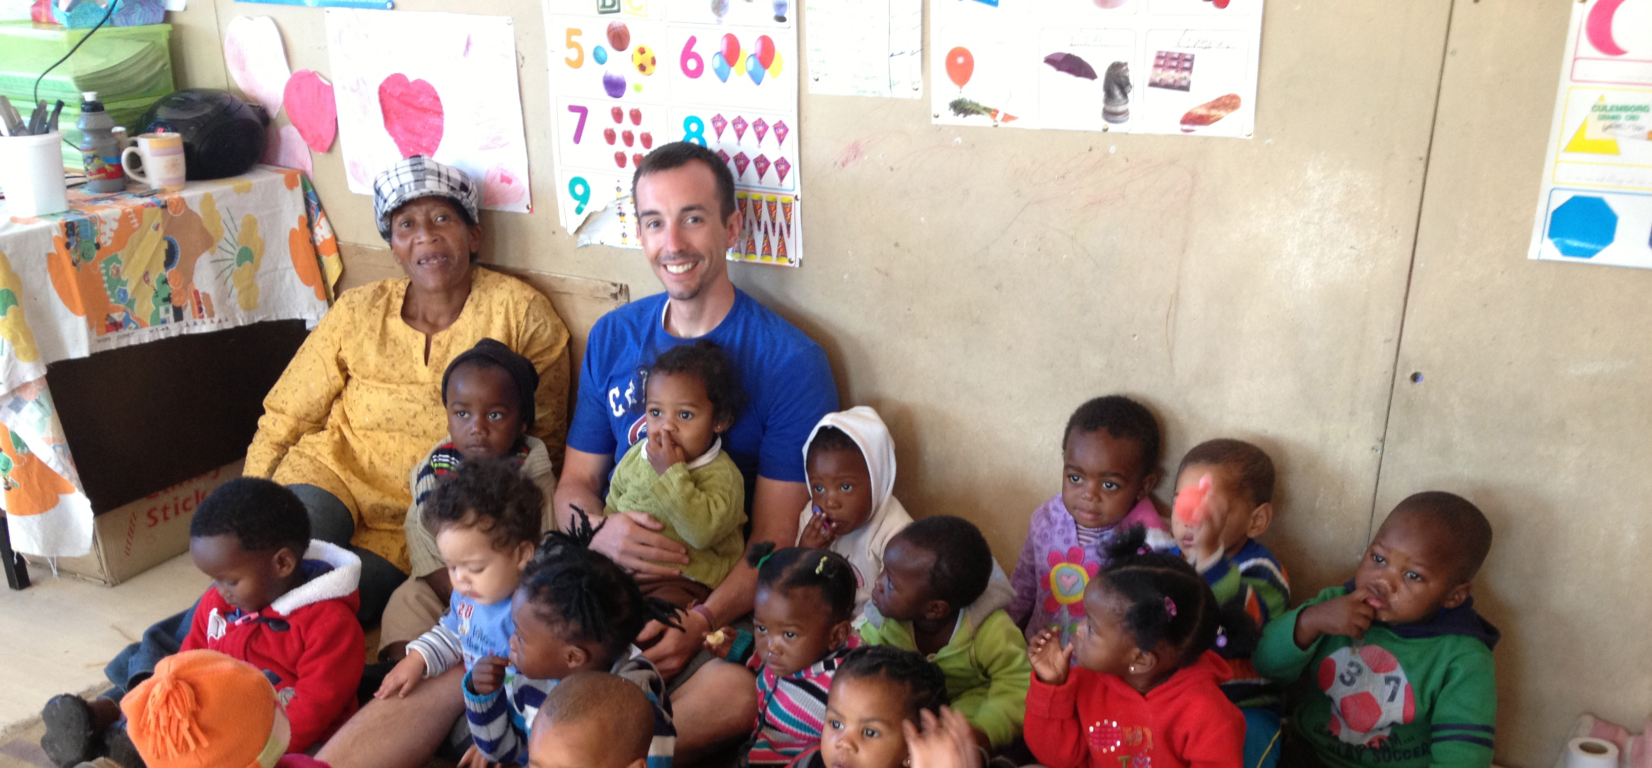
The Business of Doing Good
As a senior associate at the financial services firm KPMG, Matt Austin ’09 audited U.S. subsidiaries of foreign banks. He won the company’s prestigious chairman’s award. Austin also spent three weeks volunteering at a childcare center in South Africa where many children have lost a parent to drugs, crime or AIDS. Today he is intent on using his business savvy to start a nonprofit organization.

Slide 12
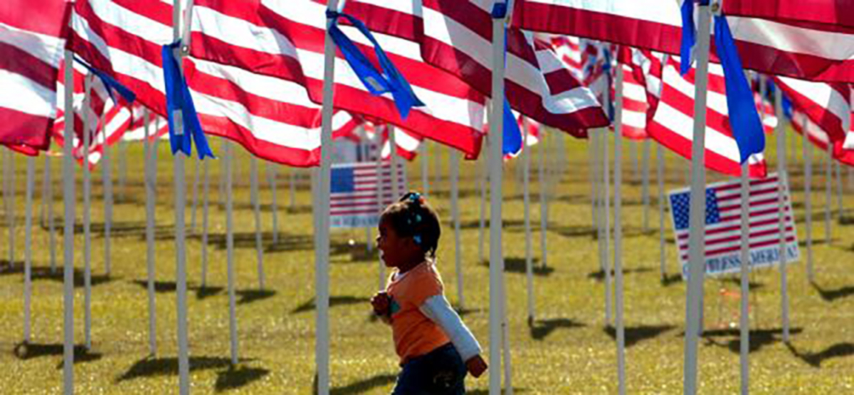
Lending a Big Voice to Little People
Britton Bouchard ’16 recently attended the prestigious Student Conference on Veterans Affairs at the U.S. Military Academy at West Point, where he grappled with weighty issues such as economic inequality. A Marine Corps veteran, Bouchard has a long-term goal of becoming an attorney specializing in representing abused children.

Slide 13
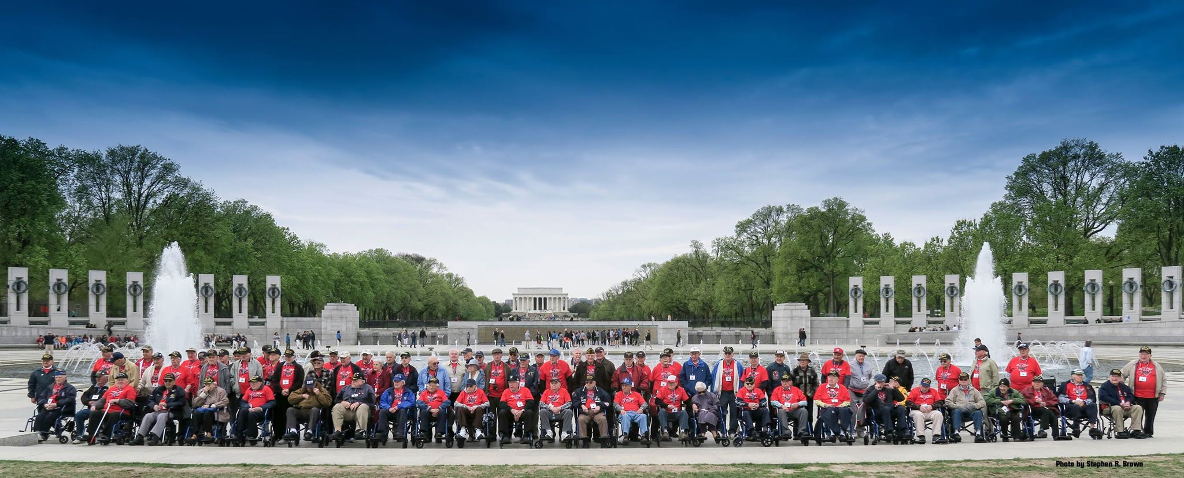
Flying with Heroes
A group of nursing students gained valuable experience – and an incredible lesson in history – when they accompanied 62 veterans to Washington, D.C., as part of the Honor Flight Network. The organization was created in 2005 to bring veterans to the capital to visit monuments created in their honor.

Slide 14
At Le Moyne, greatness meets goodness.
One without the other is simply not an option.
lemoyne.edu

